Slide 1
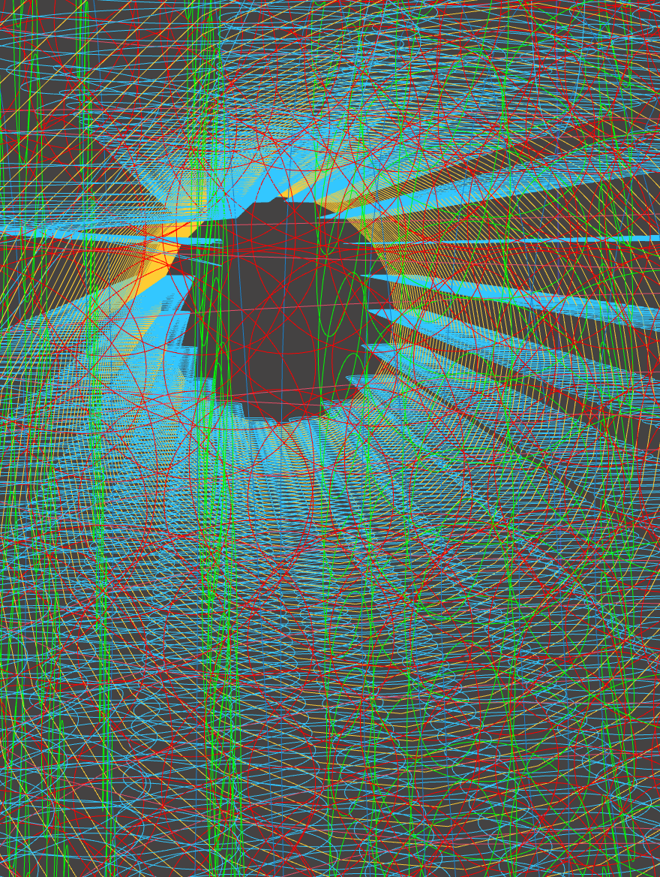
P0
<Computational Design Thinking>
<Generative Design>
P0
Assignment
Context
Course
Date
Generative
Design
Freshmore
Term 1
Computational
Design Thinking
2/10/2024
Student
<The Junction>
The initial idea was to model the movement of the moon around the Earth, and the Earth around the Sun, an orbit around an orbit. In trying to achieve that, multiple variables, parameters and mathematical functions were used to bring the final design closer to that goal.
Ultimately, that end goal proved too great a challenge to model. However, while trying to achieve that goal, various iterations yielded interesting designs.
The image on the right shows part of the final design, looking outward from inside the cylinders.
The final design is reminiscent of tunnels and other man-made landscapes, looking at any of the axes, one can see a tunnel or a tower. Looking at the structure from various vantage points reflect various structures in the modern world.
Tan Rui Anh
1008752
Instructor
Zheng Kai
Dr.

Slide 2
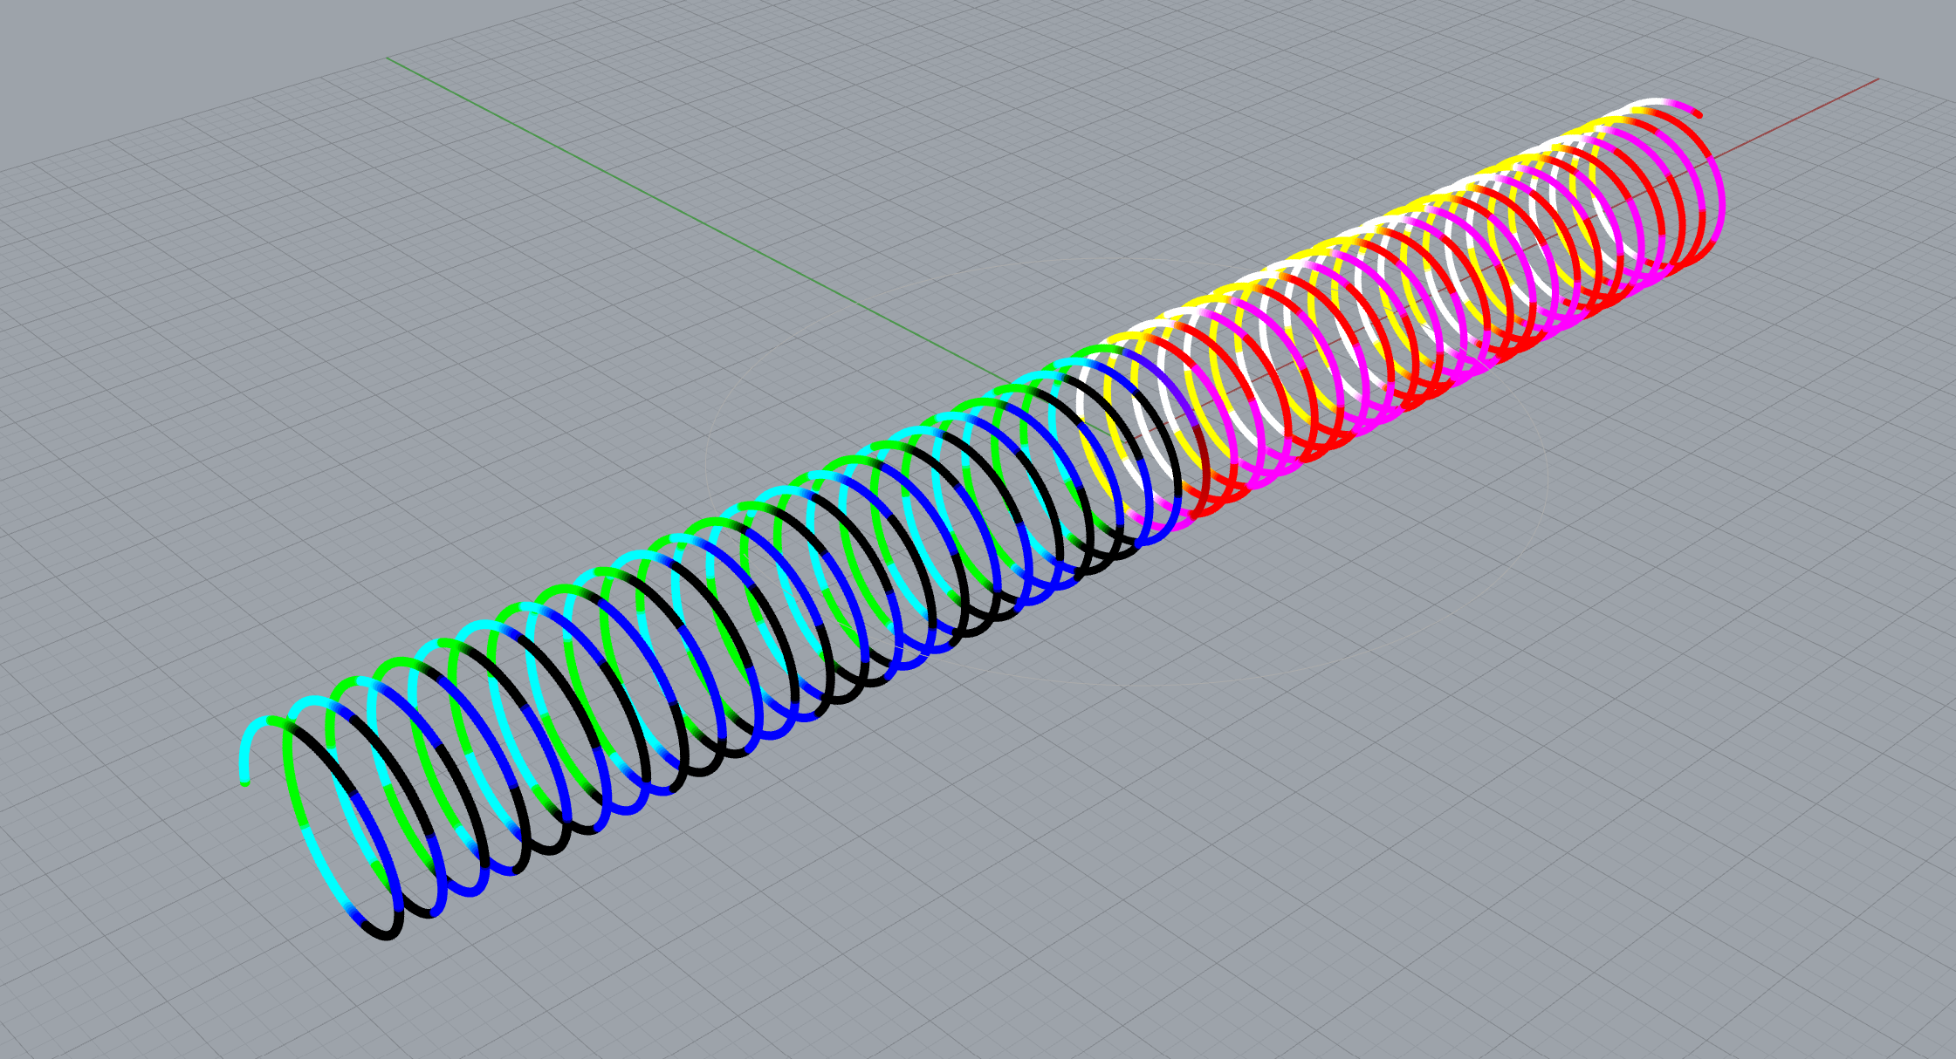
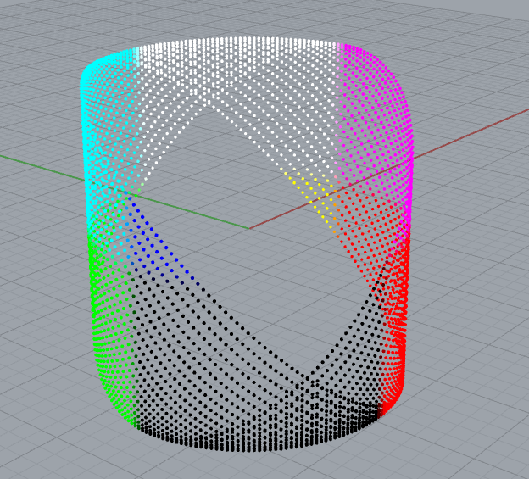
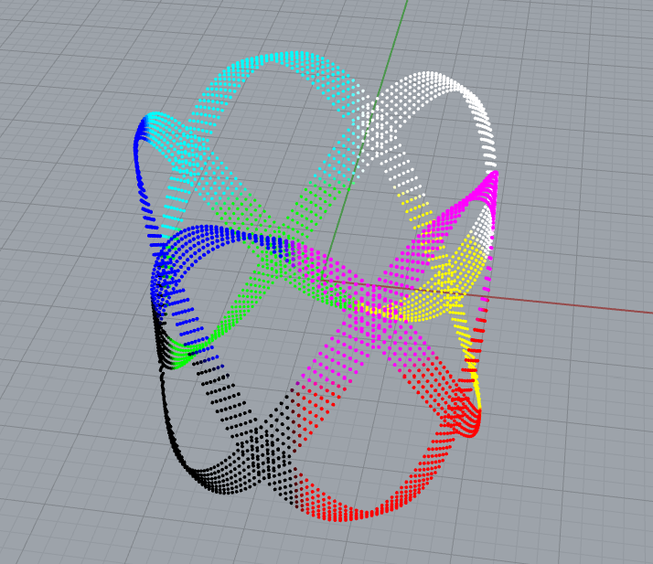
P1
<Computational Design Thinking>
<Generative Design>
P1
<Testing Phase>
At the base of this design is a simple circle, feeding values into the z-axis gave rise to several interesting shapes such as those seen in 1 and 2.
Initially, the z-values were derived from a sine function, thus the familiar curves in image 2.
By swapping the z and y values, and feeding a regularly increasing y value, a spring emerged. This parallels the orbit of the Moon around the Earth, while the Earth is in motion.
As alluded to earlier, there were some difficulties in trying to close the spring, to form a circle using the spring.
Later images will feature some patterns that have emerged while attempting to overcome this challenge.
Captions
01 Spring
02 Wristband
03 Patterned Cuff
01
02
03

Slide 3
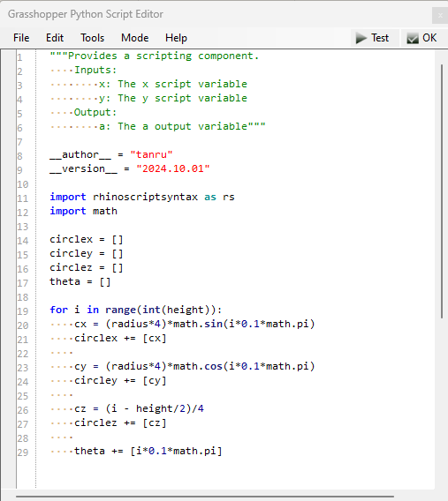
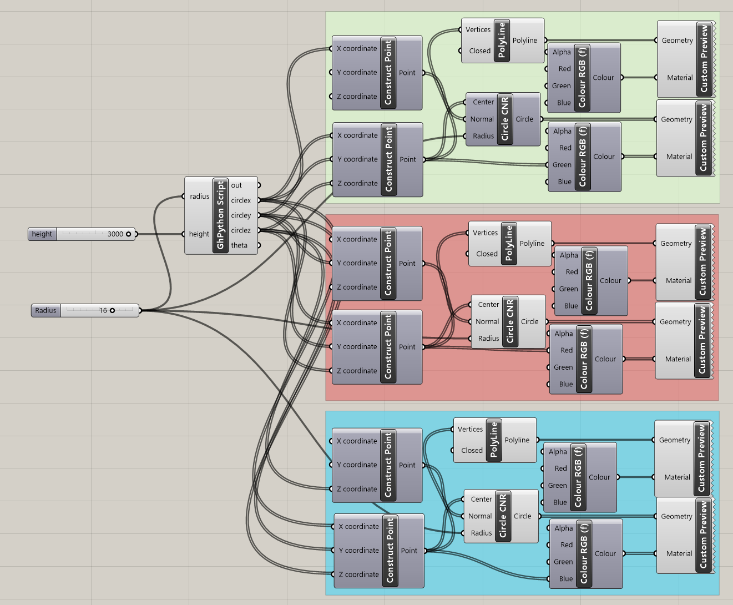
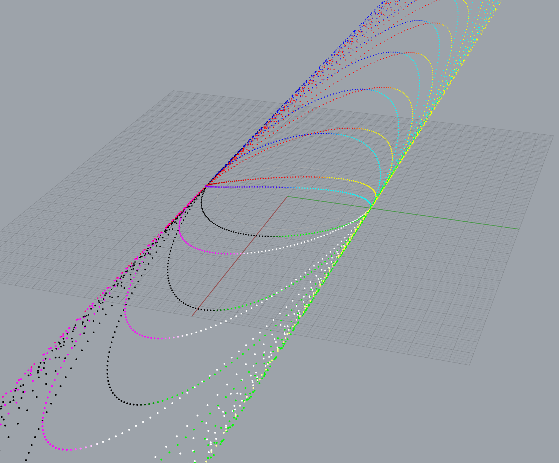
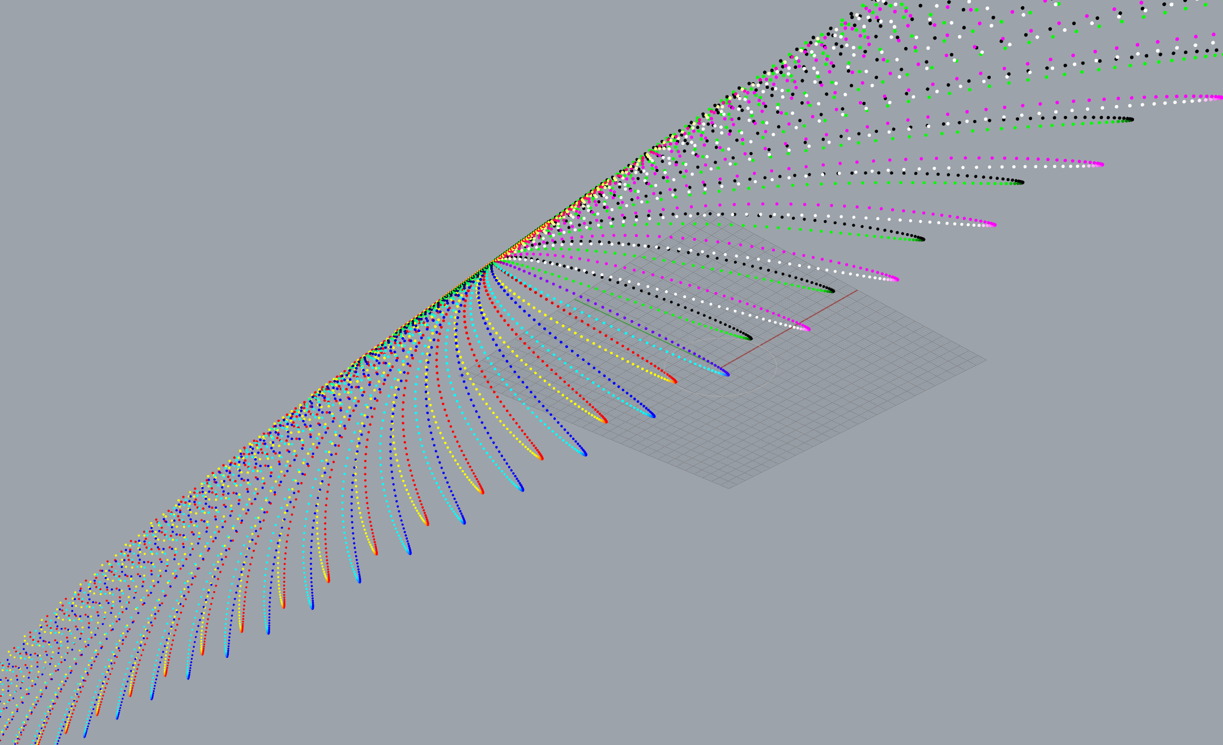
P2
<Computational Design Thinking>
<Generative Design>
P2
Captions
01 Python component
02 Final Program
03 Expansion
04 Emergence
01
02
03
04

Slide 4
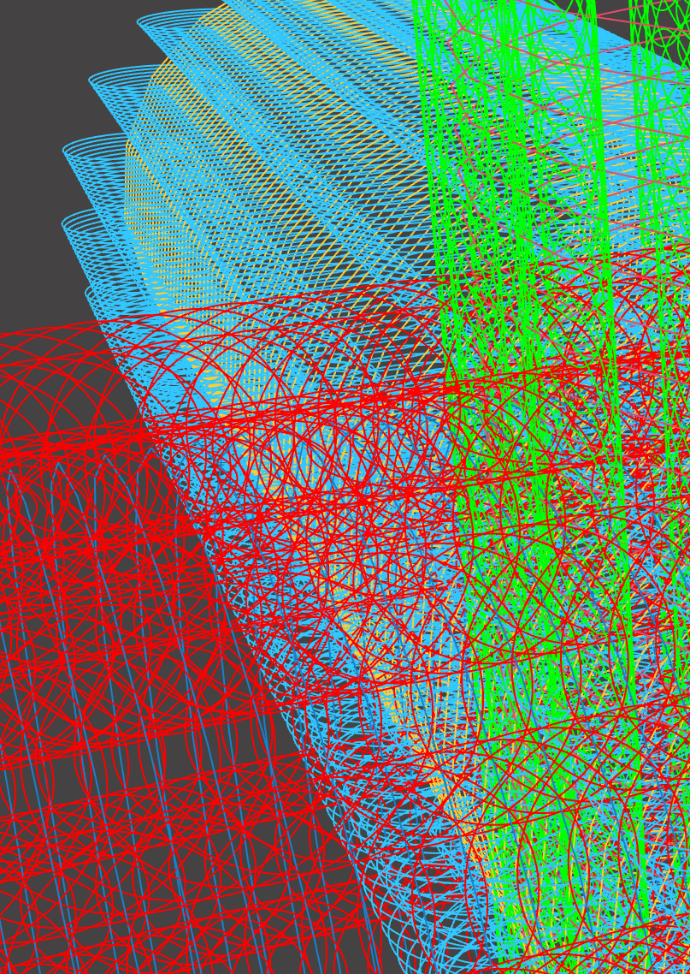
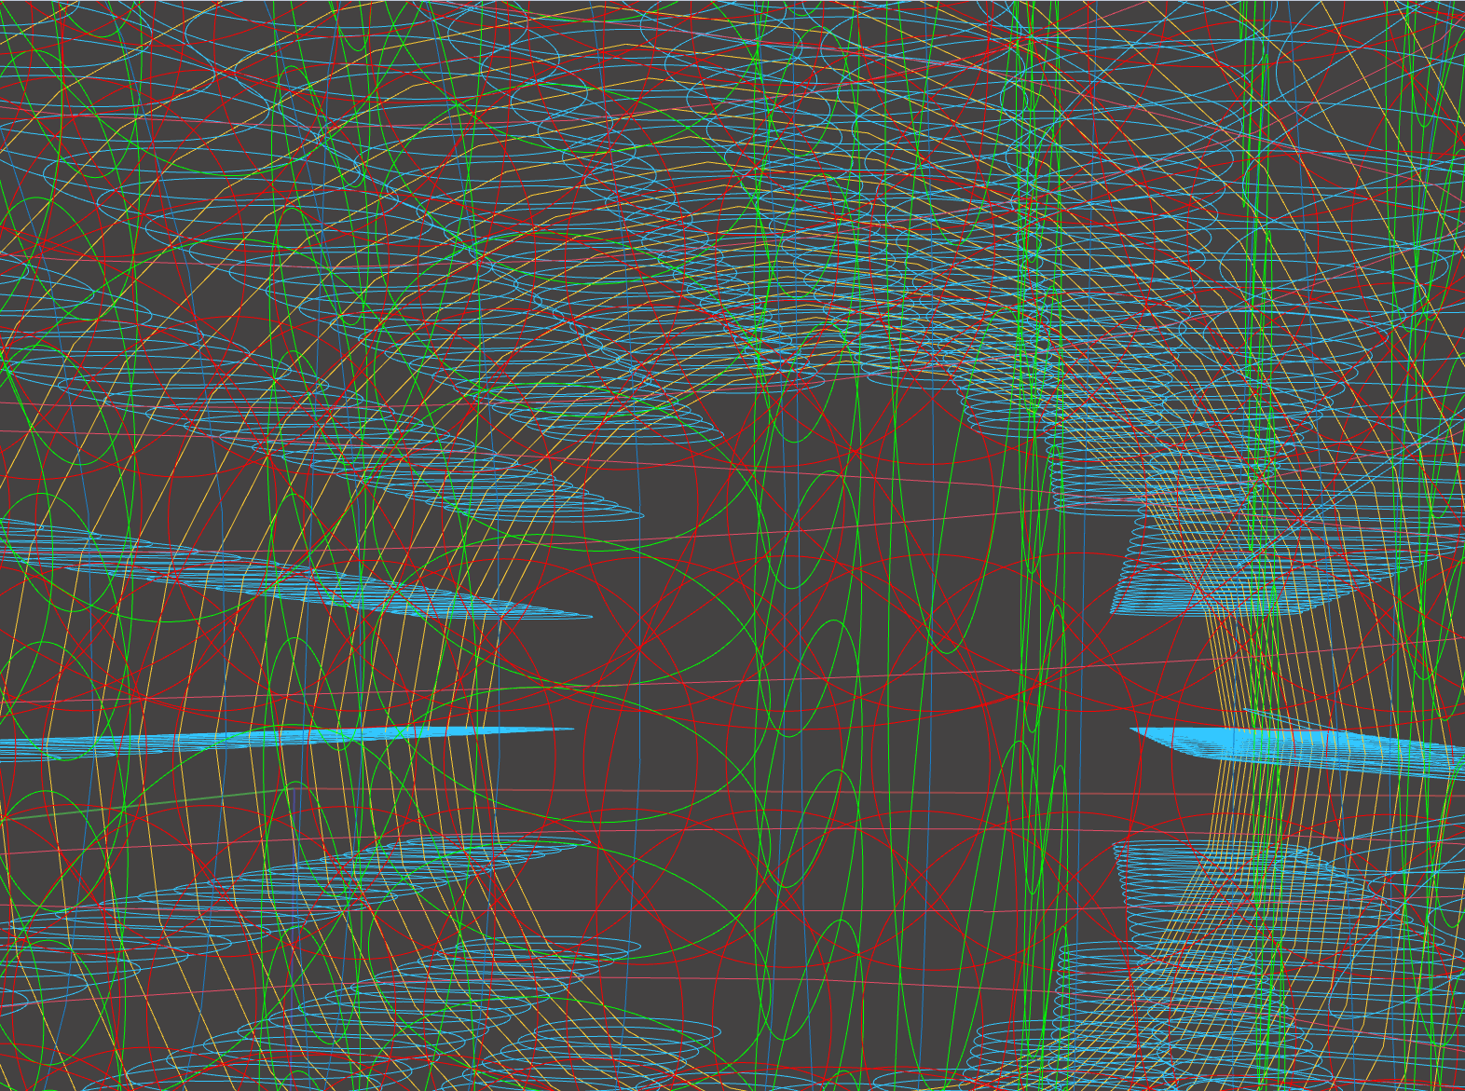
P3
<Computational Design Thinking>
<Generative Design>
P3
<The Final Design>
The final design flipped the original idea on its head, instead of having a spiral around a circle, it puts circles around a spiral.
By reflecting the original column about the other axes, a 6-way joint is formed. Several recognizable formations can be observed from various vantage points on the structure, like tall columns, or underground tunnels and intersections.
Captions
01 Intersection
02 Inside the tunnel
01
02

Slide 5
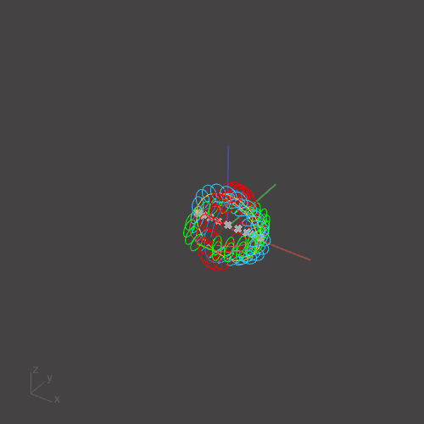
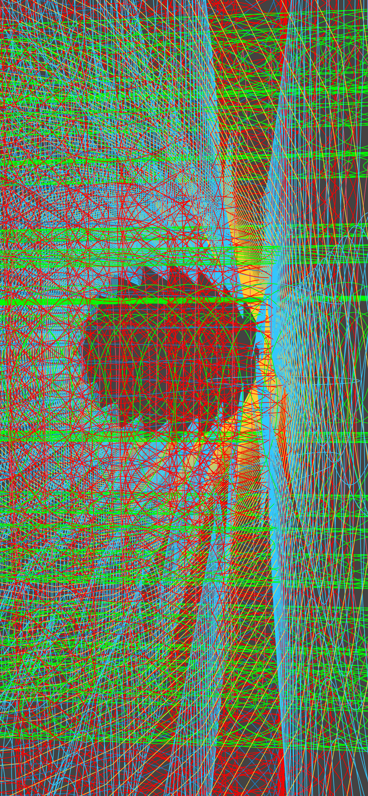
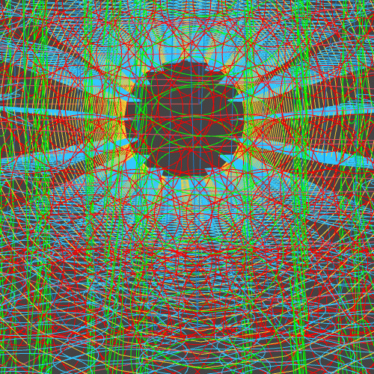
P4
<Computational Design Thinking>
<Generative Design>
P4
Captions
01 Looking up?
02 Growing tunnels
03 Inside look
01
02
03

